Slide 1
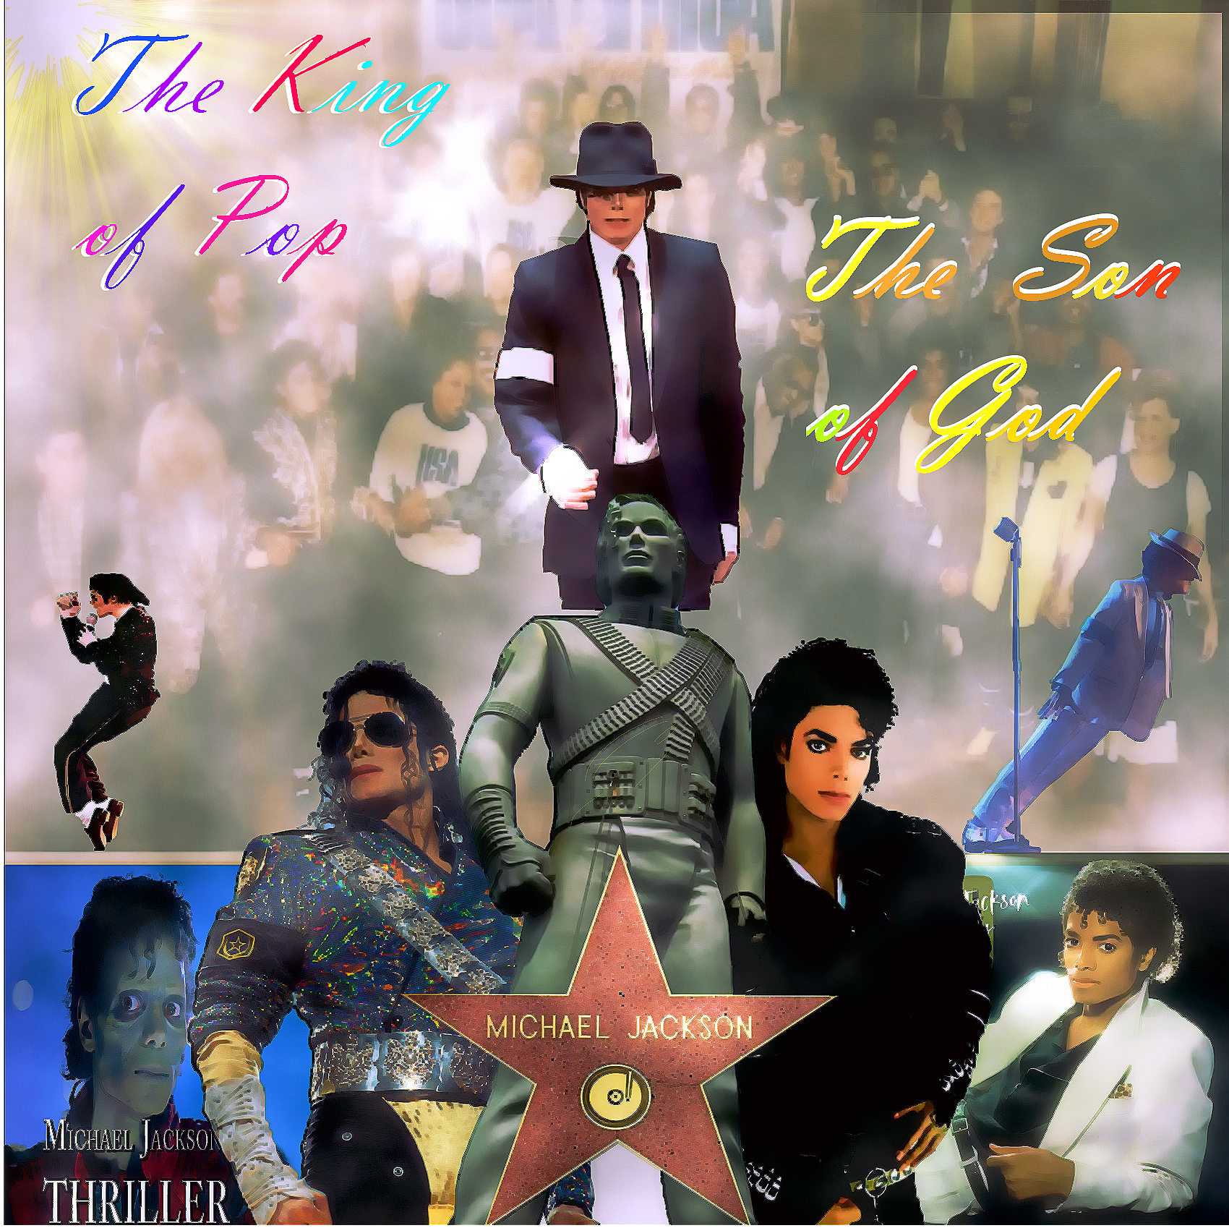

Slide 2
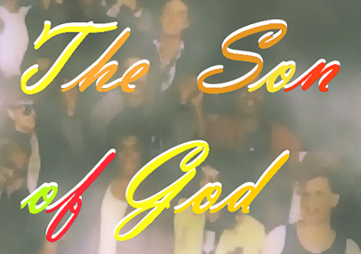

The King of Pop是迈克尔杰克逊最为人所知的称号，也表现出他对于现代流行乐的贡献及他的超然地位
The Son of God是迈克尔杰克逊高尚人格的写照，他被广大粉丝们称为天使，也代表了偶像群体的人性与良知

Slide 3
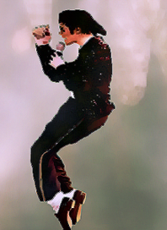
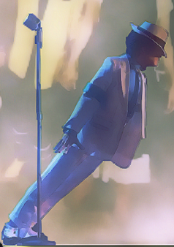
右图为45度前倾动作。这个动作出自迈克尔著名的歌曲《smooth criminal》（《犯罪高手》）
迈克尔杰克逊在这首歌曲及MV表达了对嫖娼，赌博，吸毒，杀伤等恶劣行为的强烈批判。
与之类似，另一首迈克杰克逊的歌曲《Beat it》则是反对黑帮与街斗的著名作品
迈克尔杰克逊是全世界公认的舞王。
他创造性地改进了滑步使之成为“太空步”，创造性地发明了45度前倾等高难度舞蹈动作。

Slide 4
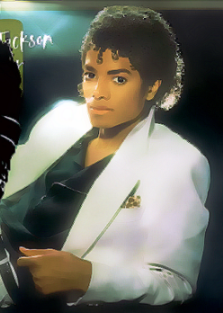
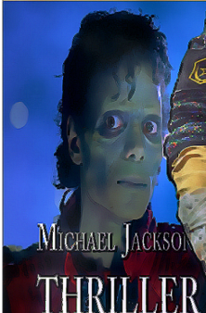
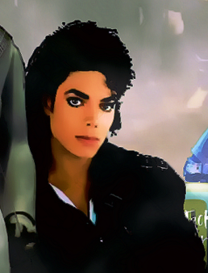
《Bad》迈克尔销量第二高的专辑
左图为Michael的传世专辑《Thriller》
该专辑为Michael也即全世界销量最高的专辑，至今无人能够超越。
该专辑含有《Billie Jane》《Beat It》等脍炙人口的歌曲
而右图为专辑同名歌曲MV中的经典造型，而这一MV也是世界剧情MV的开山之作
这表现出迈克尔杰克逊在音乐，造型等领域的极高造诣与开创性
可以说Michael是当之无愧的全能型艺人

Slide 5
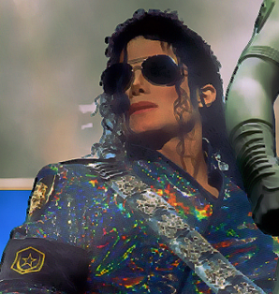
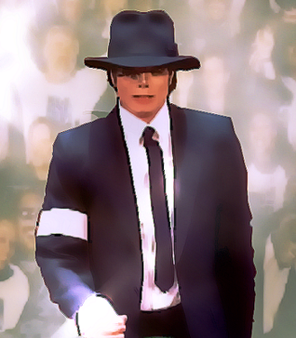
Right above shows two of most classic images of Micheal Jackson.
The left picture was taken when Micheal was holding his concert of his new song ,Jam.Differing from his previous songs featuring mainstream pop music,this song was once not fully accepted as a result of its avant-garde style of singing skills and rythm.
The right one was taken when Micheal was participating in the award ceremony of MTV in 1955.
As every one can see either in the live concerts or in the films directed by Micheal,the most well known of which is Ghost,his image was multiple,fashionabile and changeful.This not only fully indicates his advanced,unique and appealing understanding of fashion,but also shows his overwhelming global influence and personal charisma.

Slide 6
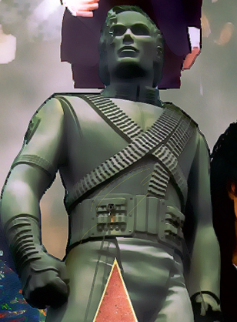
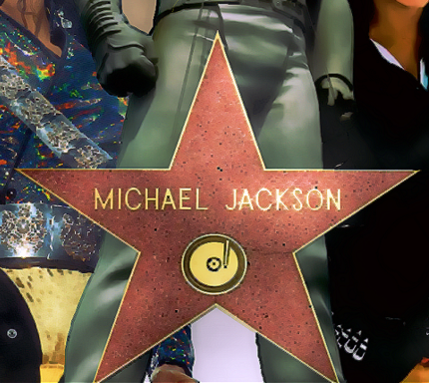
In the middle of the picture is a statue of Micheal Jackson,originally aiming at the publicity of his album History,but later becoming one of his greatest symbol.
The star awarded to Micheal Jackson at the Hollywood Walk of Fame in 1984 in honor of his great contribution in pop music and philanthropy.

Slide 7

Also of primary note is one of the most well-known and touching songs written and composed by Micheal Jackson and Lionel Richie--We Are the World,the creating process of which has involved the majority of American celebrities in all fields of music.
Not only did this song distinguish itself with its brilliant musical and artistic outcome of exceptional standards,but also did it touch the bottom of countless people’s hearts with its contagious call of love,as well as its genuine concern for those who’re suffering,which has made it in a league of its own in music and humanitarianism.
This,however,was only a tiny part of those songs Micheal created to raise funds for people suffering from wars and natural disasters,including Earth Song calling for natural conservation,Heal the World calling for worlld peace,and so on.

